Slide 1
ArcStyler: The Architectural IDE for MDA
Richard Hubert, CEO
© Interactive Objects Software – info@io-software.com
Notes:
Tokyo: Title: Applied MDA for J2EE and Web Services
Length: 1 hour.
Language: E
Abstract:
When properly applied, Model Driven Architecture can relieve the largest cost and risk factors of the IT life-cycle. This presentation shows how major pay-offs from MDA are achieved when automated in the context of a holistic architectural style. In addition to a crash-course in MDA concepts, it shows how the results from each concept are achieved in practice and how modern tools (e.g. Rose and JBuilder) are integrated and enhanced to explicitly support end-to-end MDA as part of an overall architectural approach. The presentation shows the positioning of several levels of MDA within the Unified Process (RUP) and management of PIMs and PSMs for all four tiers of the J2EE 1.3 blueprint with EJB 2.0 across various application servers. It also shows high-end MDA support for Web Services, process workflow as well as build, deploy and test environments.
Presenter:
Richard Hubert is CEO of iO-Software and author of the recent OMG Press book
“Convergent Architecture: Building model-driven J2EE systems with UML”, John Wiley, OMG Press, Foreword by David Taylor. ISBN 0-471-10560-0 www.ConvergentArchitecture.com
From J. Wiley:
RICHARD HUBERT is an accomplished software architect who has won numerous international awards for large-scale software systems and architectural tools. As founding director of Interactive Objects Software GmbH (iO), he leads a large team of professional architects who apply Convergent Architecture across diverse industry segments. In 2000, iO introduced its Architectural IDE for MDA, ArcStyler (www.ArcStyler.com). The author is also an active contributor to the OMG’s MDA standardization effort.

Slide 2
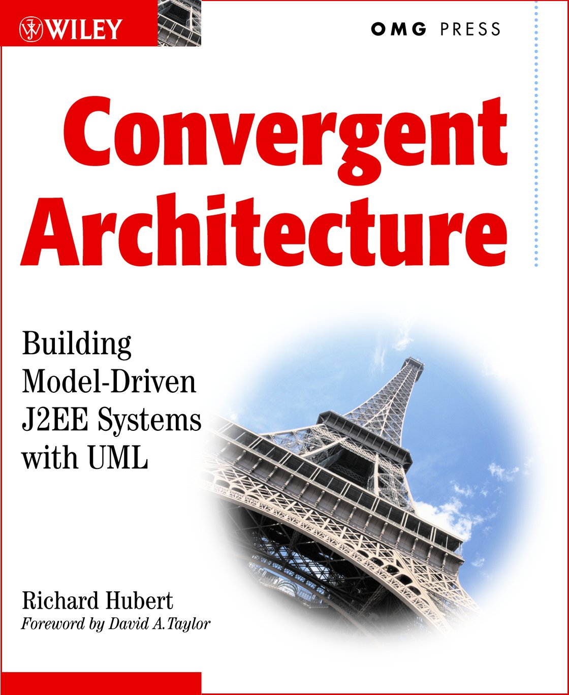

Many of these concepts/slides are from the book:
(J. Wiley, New York, 2002, ISBN 0-471-10560-0)

Slide 3
Automating Architecture
"Civilization advances by extending the number of important operations we can perform without thinking"
- Alfred North Whitehead, Philosopher

Slide 4
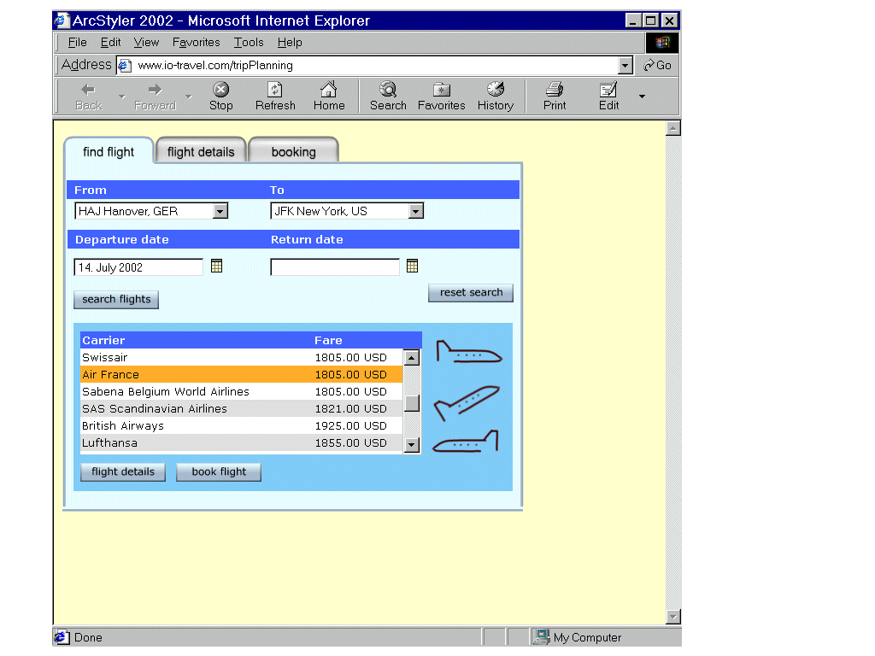
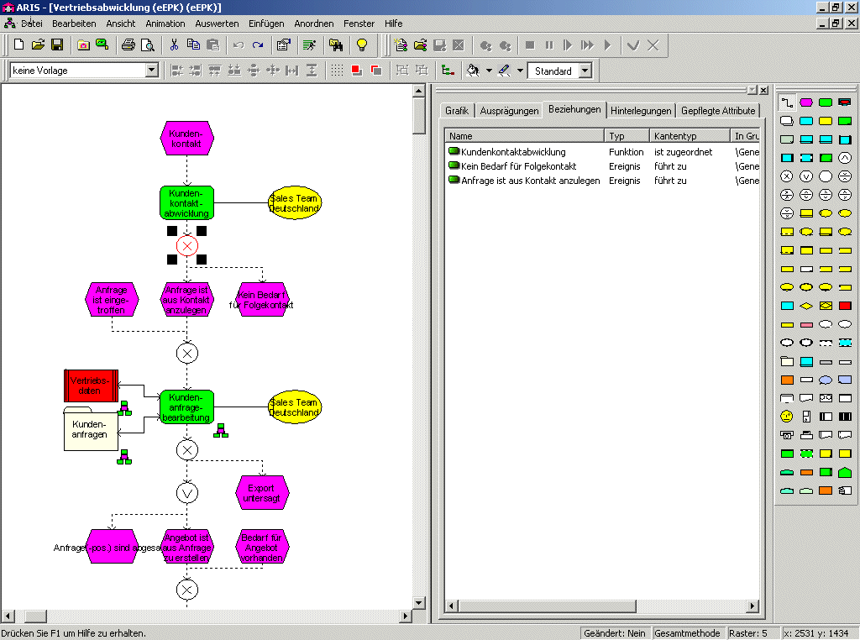
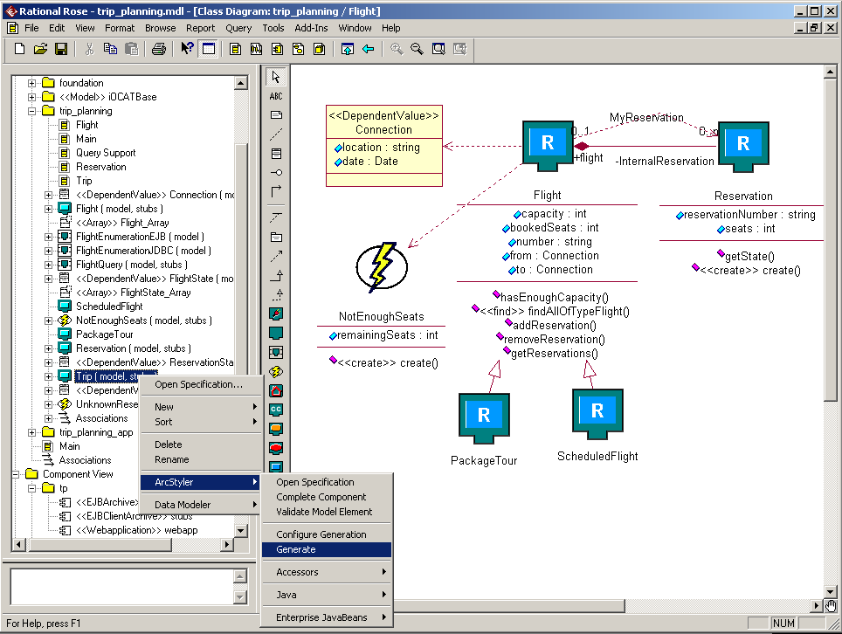
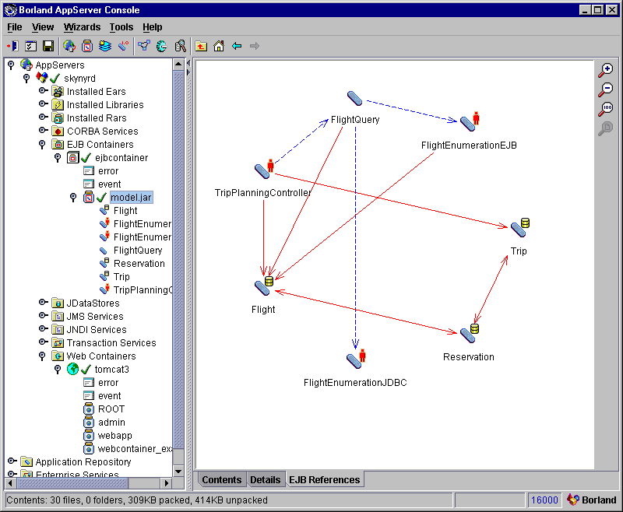
The Vision: Business-IT Convergence
Business Process Modeling
MDA Automation
Refinement, configuration &
extension using open UML
MDA Automation
Deploy, Test, Manage on
diverse platforms: J2EE, Host, .Net and custom…

Slide 5
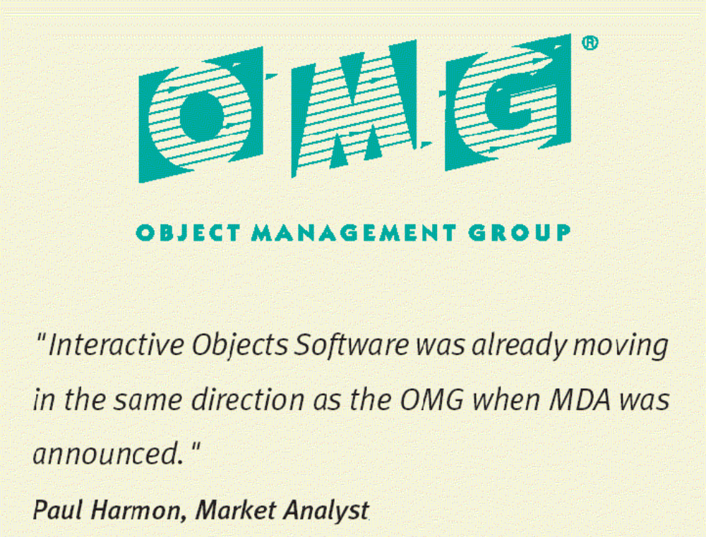
An OMG member since the early 90‘s

Slide 6
Interactive Objects Software (iO): Overview
Interactive Objects was founded 1990
Successful in applied Architectural Consulting
  “Chief Architect” positions in many Fortune 500 companies
Profitable
  Significant R&D investments (> 20%)
Launched ArcStyler Product Line in 2000
  Based on a decade of reality-scale consulting
  Is proven ROI-effective in production environments
  Defines/substantiates a new class: the Architectural IDE

Slide 7
A New Class: The Architectural IDE
An Architecture-centric Platform
  Above and beyond programming IDEs
  Enforces architectural standards and architectural integrity
End-to-End Systems from Models (UML, BOM)
  Generates optimized infrastructure for diverse environments
  J2EE 1.3/EJB 2.0, Web Services, .NET, CORBA, Cobol, Host
MDA Programming Environment (MPE)
  To MDA enable your existing or new infrastructure
  ArcStyler: a “runtime platform” for standard and custom MDA support, whether developed by iO, its customers or partners

Slide 8


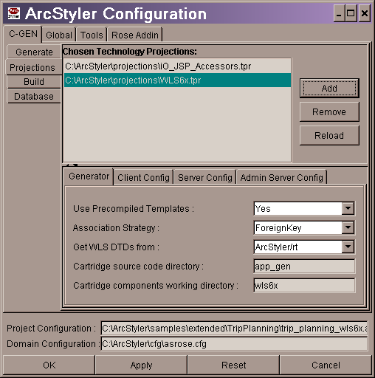
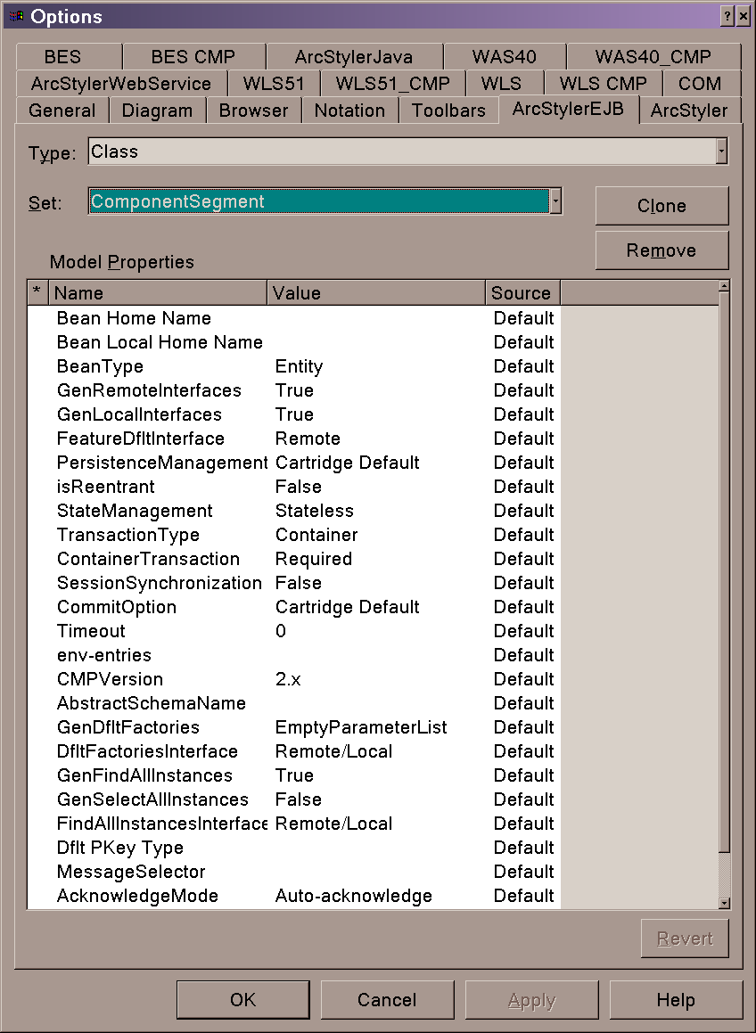
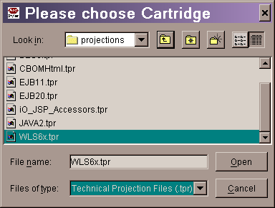




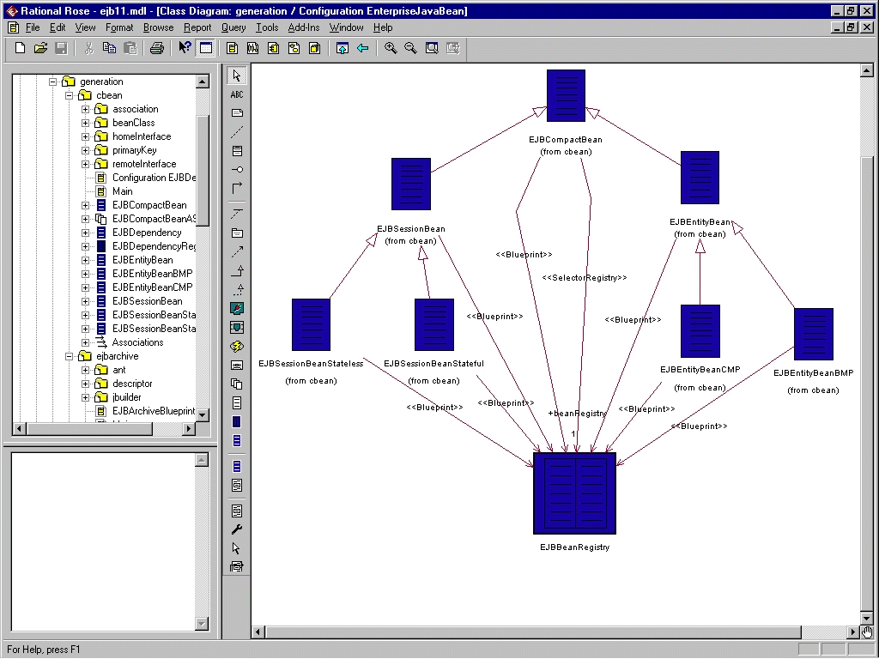
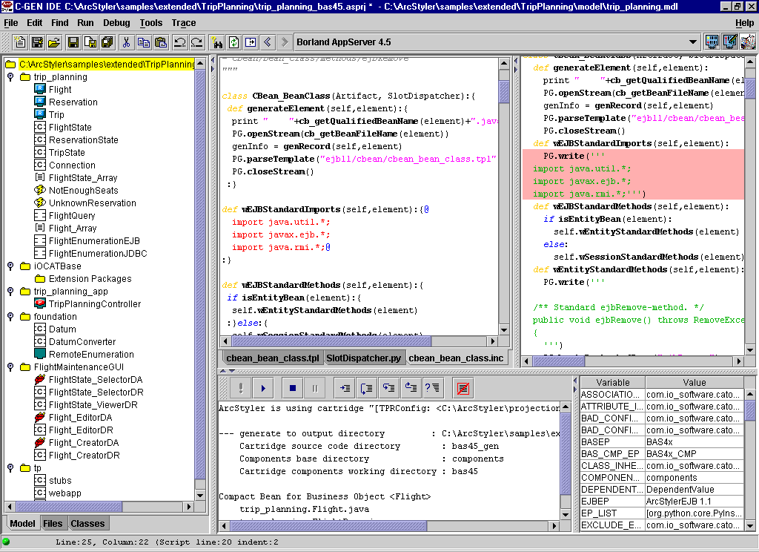
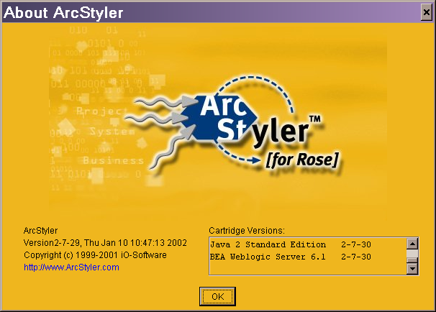



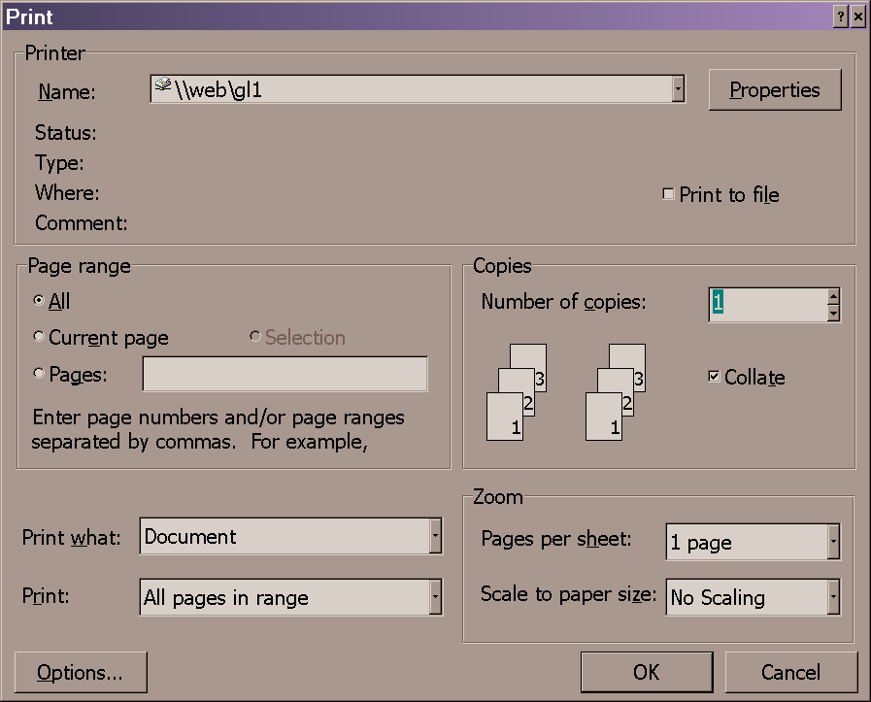
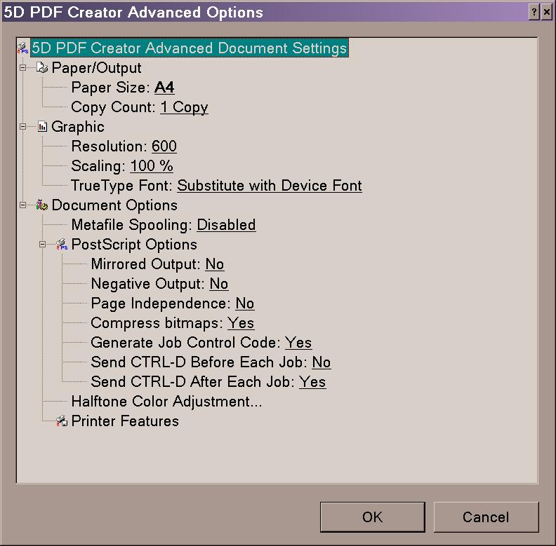

A big problem, and the solution: Pluggable MDA Cartridges…
CARAT
™
Pluggable MDA™ Cartridges
standard
Use
Cartridges
Set Gen. Options
Configure Server
Add Cartridges
MDA Programming IDE
Produce
Cartridges
Custom Infrastructure
CORBA, .NET,
OODB, COBOL, etc.
Architectural IDE
Model & Gen.
Refine & Test
Package Cartridge
PostScript
™
Pluggable Print Drivers
standard
Install
Printer
Driver
Desktop Publishing
Systems
Set Print Options
Configure Printer
Install Printers

Slide 9
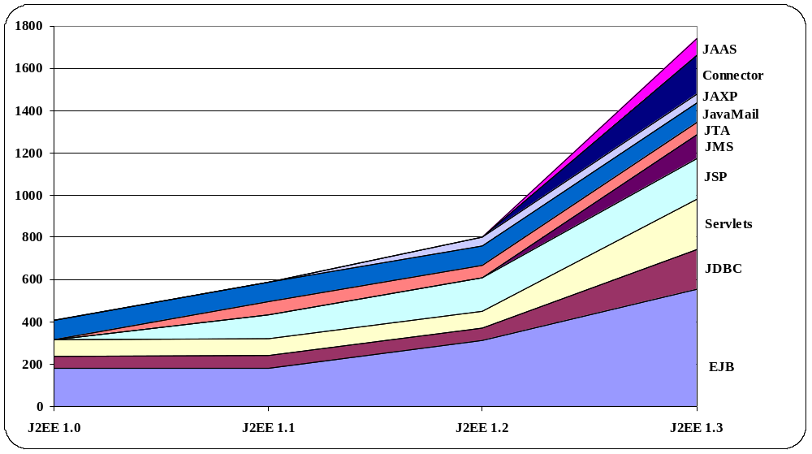
Its about automating ROI of infrastructure (J2EE, .NET, custom)
Number of pages
Widening scope
Notes:
Posted by: Dave Miller on January 15, 2002 in
http://www.theserverside.com/home/thread.jsp?thread_id=11273
“It was *really* tough getting started. J2EE is a great platform but we spent 4 weeks just reading books and pouring over TheServerSide forums trying to "get it". It was really, really tough and I've got 18 years of development experience.
The average programmer probably would just give up. “
---

Slide 10
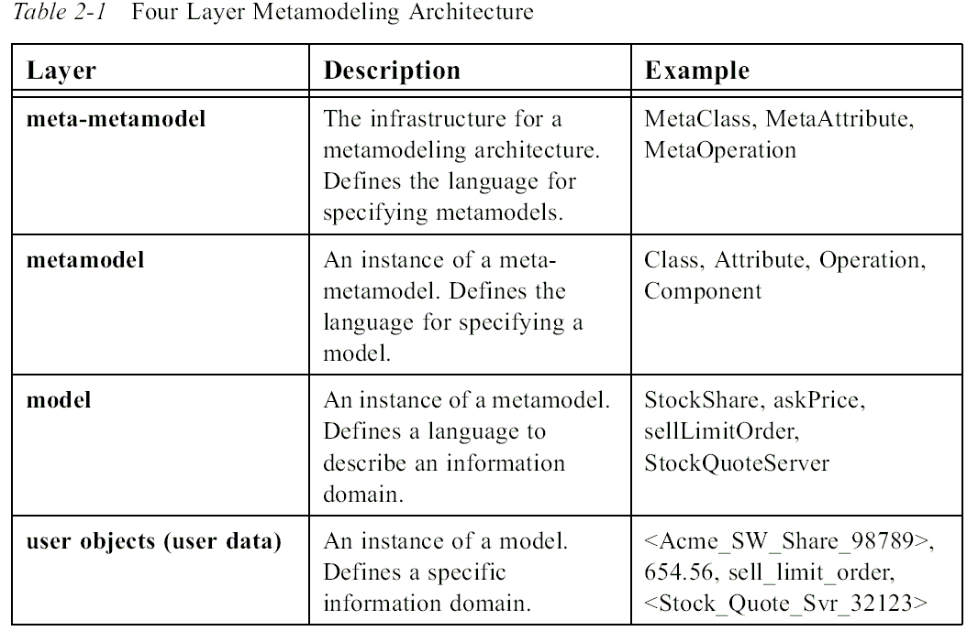
and making UML easy to use and effective…
From the OMG’s UML 1.4 Specification, 2002

Slide 11
Focusing on The Business of IT Architecture
Stable evolution of your business designs
The
Business of
high-ROI
Business
Solutions
Convergent MDA mapping for
business continuity.
The
Business
Of IT-
Architecture
Means
supporting
this with
optimized
automation.
Stable evolution of your UML models
Convergent MDA mapping for
business continuity.
Managed Evolution of Service Infrastructure:
EAI, framework standards, custom
e.g. J2EE/EJB, .NET, Host, SAP
Optimized mapping for
effective usage and ROI.
BEA, IBM, Borland, IONA, MSoft, …

Slide 12
The first level of automation. ~30 Years
Programming IDEs (e.g. JBuilder, Visual Age, NetBeans)
Environment
Higher level
of expression
Easier to
understand
Portable
Standardized
PIM
Programming Language
Dependable
Flexible
Configurable
Optimizing
Complete:
Linker,
Debugger,
Etc.
Generator,
Projection
Compiler Engine
1st
P-stack
PSM
Diverse HW/OS Platforms

Slide 13

MDA = New levels of automation ~ Last 8 Years
Architectural IDEs
Environment
Higher level
of expression
Easier to
understand
Portable
Standardized
PIM
Model (UML, BOM…) &
Modeling Style (J2EE, eEPC, COBOL, .NET…)
4th
3rd
Dependable
Flexible
Configurable
Debuggable
Optimizing
Complete
2nd
Generator,
Projection
Translative Generator Engine
P-stack
Models to Code
Models to Models
P-Stack: A Level of Automation
PSM
1st

Slide 14
ArcStyler/MDA: Objectively high ROI
Complete
Systems
Change Platforms 2 & 1
Deployable Infrastructure
on Target Platform,
Completely Specified.
Rework effort
using high-end
Architectural IDE
Rework effort
without high-end
Architectural IDE
MDA automation lines
Effective representation
(modeling styles) and
automation begins in
higher P-stacks: ArcStyler
Content Level
(extent of convergent metamorphosis)
ArcStyler:
ROI with each
and every
change.
Effective representation
and automation begins at
lower P-stacks.
Manual Rework Lines
Whiteboard
Sketches
PIM -> PSM “P-stacks”
P-stack N+1
P-stack N
P-stack 2
P-stack 1
Level of MDA automation
From Interactive Object’s OMG MDA contribution Dec. 2001
http://cgi.omg.org/cgi-bin/doc?ormsc/02-01-04.pdf

Slide 15

ArcStyler® 3: Managing Corporate Architecture
MDA-Vertical
Standards
Optimized Business
Domains and Grids
e.g. eGovt, ERP
Specialty
Service Based
Architectures
Specialty Security
and EAI
Industry Standard
ebXML/B2B
Models
MDA-Horizontal
Standards
Standard Security
Web Services & Internet Services
J2EE/Java
CORBA
.NET
MDA-Cartridges™
Automating
Architectural Styles
Custom MDA Cartridges
Standard MDA Cartridges
MDA™ Meta
Development
Environment
MDA Development IDE: Model and Mapping Development
MDA-Engine and Convergent Model Repository
Optimized integration
of other tools
JCA Connectivity and
Custom Connectivity
MDA-Engine™
And
Development
Process
Automation
High-end support for convergent MDA: Model-to-Model, Model-to-Code etc.
Business
Modeler
Convergence
Assistants
Assembly
Modeler
Build, Deploy,
Test Manager
Process
Modeler
Pattern
Assistants
UML Engine
(Rose/XDE)
Programming IDE
Oracle
JBoss
Model
Driven
Platforms
J2EE/EBJ/Java
optimized
.NET, CORBA
optimized
Host, Custom
and Std. Apps
EAI, Legacy and
Process Engines
Contains patented or patent pending technologies

Slide 16
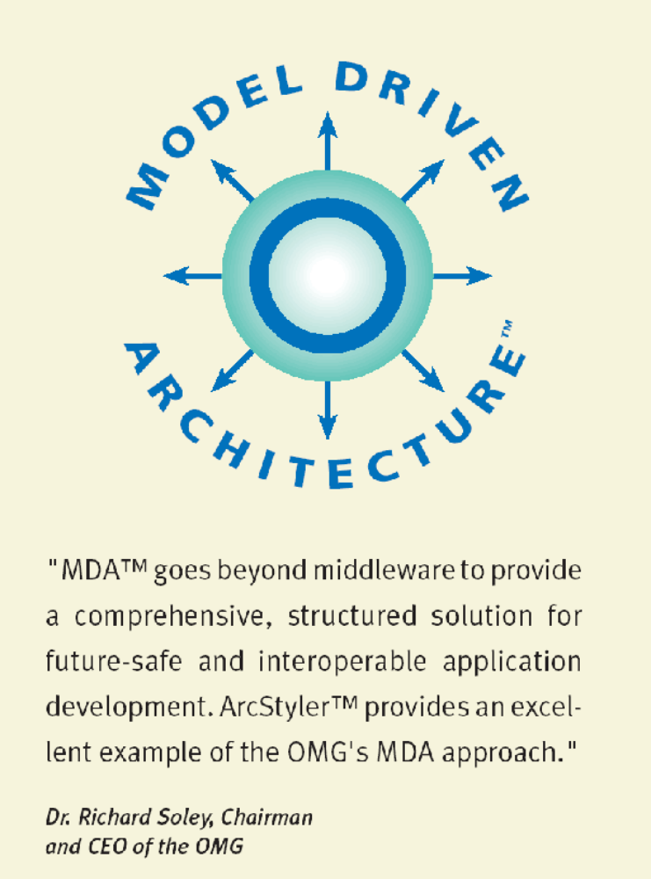
ArcStyler realizes Model Driven Architecture
Notes:
Was wird machen wird standardisiert!
Den Ansatz verfolgen wir schon seit 10 Jahren, jetzt wird es mainstream!
Interactive Objects Software contributes
Co-Author of the OMG Paper regarding MDA (Axel Uhl)
OMG Award Winner (twice) for Convergent Architecture
Book on Convergent Architecture / MDA (Richard Hubert)
ArcStyler: Architectural IDE for MDA with proven quality
Four years of development time for the Architectural IDE
MDA Concepts in use for years
Large install base and first class support (A-List award)
IBM solutions excellence award, European IST Winner

Slide 17
Managing Corporate Architectural Style
4th*
3rd*
2nd ...*
1st*
The Unified Process
Std. MDA Projections
ArcStyler Core Modules
J2EE/EJB, .NET
Open UML/XML (XMI) Repository
BEA WebLogic
MDA Cartridges
Business
Object
Modeler
Pattern
Refinement
Assistant
UML
Refinement
Assistant
Generator
Engine
with Meta IDE
Build,
Deploy & Test
Support
IBM WAS NT, z/OS
Optional integrated Tools
Borland BES
IDS ARIS
Rational Rose
Java IDE
IONA iPAS
Architectural Style Builder & MDA Programming IDE
Custom Infrastr:
CORBA, Host…

Slide 18
E.g. Automatic Migration & Refactoring (M&R)
MDA Models
MDA enabling
existing designs
Automatic merge
and refactoring
support across
new versions
e.g. BEA WLS 6.1
BEA WLS 7.1
BEA WLS 8.1
BES
E2A
E2A
and across
new products
e.g. IONA E2A
Borland BES
WAS on z/OS
IBM WAS
BEA WLS
optimizing code
each time while
maintaining
clear visibility
of the Business
Dimension.
Business Dim
Business Dim
Business Dim
Swap MDA Cartridge
Swap MDA Cartridge
Δtime

Slide 19
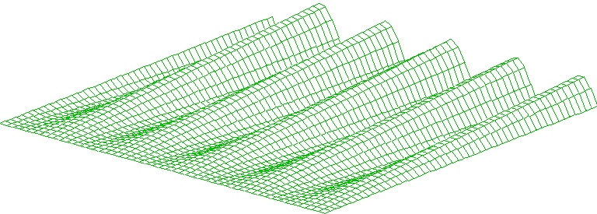
Takes the path of lowest effort & risk each time
Detailing at low abstraction level causes extra effort and errors.
Example: Associations between EJB components

Slide 20
ArcStyler/MDA Users
Professional Consultants and J2EE developers
  T-Systems, Siemens PSE, TLC
  Novartis Pharma, Dekra, KHK, RZF NRW (Govt.)
The Web Services Providers, ASP Portal Developers
  ff-eCommerce (ERP), New Wave Searchables
  IBM Logistics, FhG, dvg
The Corporate Architect, IT Director (CIO)
  Deutsche Bank, Korean Trade Bank, ABB, S/E/E
  Austrian National Railroads, BRAIN AG (ERP)

Slide 21

ArcStyler – MDA@work – high ROI
“Alone in the pilot project cost savings of approx.
US$ 16000 could be realized per seat which will increase when used on a broader basis.”
“The code quality produced by the ArcStyler’s model based generation is consistent and clean.”
Customer Case Study: ABB
Open System Advisors, INC. Boston
Best Open IT-Architectural Tool

Slide 22
MDA Demo with ArcStyler … Convergence.
Automation
Level
(P-Stack)
PIM ➔ Projection ➔ PSM
4th
Pattern based
refinement module
2 tier UML model
Business Object Model
Model to Model
Internet Accessor
generator
UML model of all
4 tiers
3rd
Two tier UML model
Model to Model
Translative
generator w/ J2EE
Cartridge.
Tuned 4
tier J2EE/EJB
environment
2nd
Four tier UML model
Model to Code
Four tier J2EE/EJB
environment
Compile, build, test
using the model
generated env.
Operative
4 tier J2EE
systems
1st
Code to Binary

Slide 23
Feature Highlights
Many of these features contain
Patent Pending Mechanisms and Technologies

Slide 24
Managing Corporate Architectural Style
The Unified Process
Std. MDA Projections
ArcStyler Core Modules
J2EE/EJB, .NET
Open UML/XML (XMI) Repository
BEA WebLogic
MDA Cartridges
Business
Object
Modeler
Pattern
Refinement
Assistant
UML
Refinement
Assistant
Generator
Engine
with Meta IDE
Build,
Deploy & Test
Support
IBM WAS NT, z/OS
Optional integrated Tools
Borland BES
IDS ARIS
Rational Rose
Java IDE
IONA iPAS
Architectural Style Builder & MDA Programming IDE
Custom Infrastr:
CORBA, Host…

Slide 25
ArcStyler Enterprise Edition
Full-cycle development process and tool integration
End-to-end support for the Unified Process:
  Business Object Modeler
  Pattern Refinement Assistant
  UML Refinement Assistant
  Generator
  Extensions, State Machine and Build Support
Business
Object
Modeler
Pattern
Refinement
Assistant
UML
Refinement
Assistant
Generator
And
Meta-IDE
Test, Build,
Deployment
Support…

Slide 26
ArcStyler Enterprise Edition
Business Object Modeler
Starting point: description of the scenarios
  Static design of the requirements with the domain experts
  in a platform-independent model (MDA specification)
  Dynamic design with use case scenarios
  Import / export models with standard XMI (UML 1.3 DTD)
  No information loss
Business
Object
Modeler
Pattern
Refinement
Assistant
UML
Refinement
Assistant
Generator
And
Meta-IDE
Test, Build,
Deployment
Support…

Slide 27
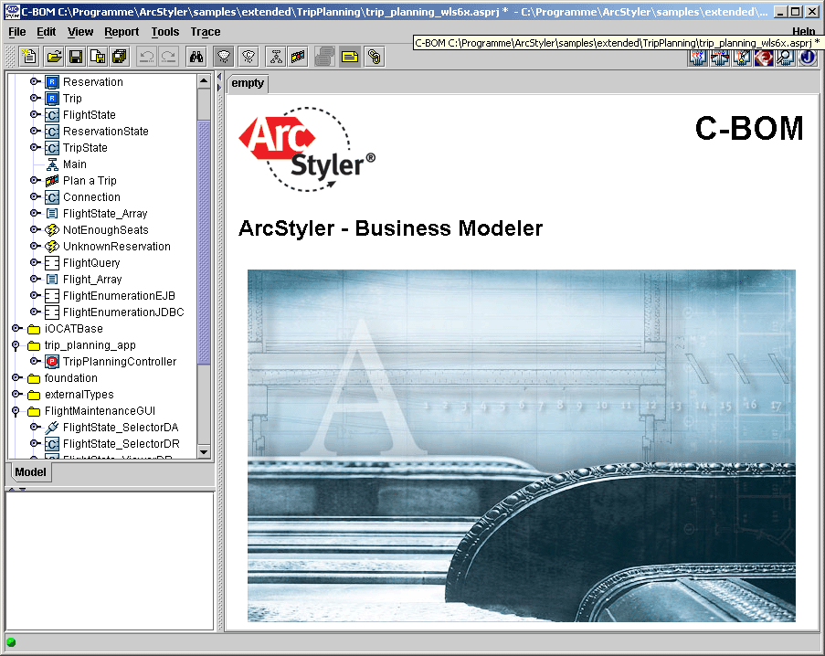
The Convergent Business Modeler

Slide 28
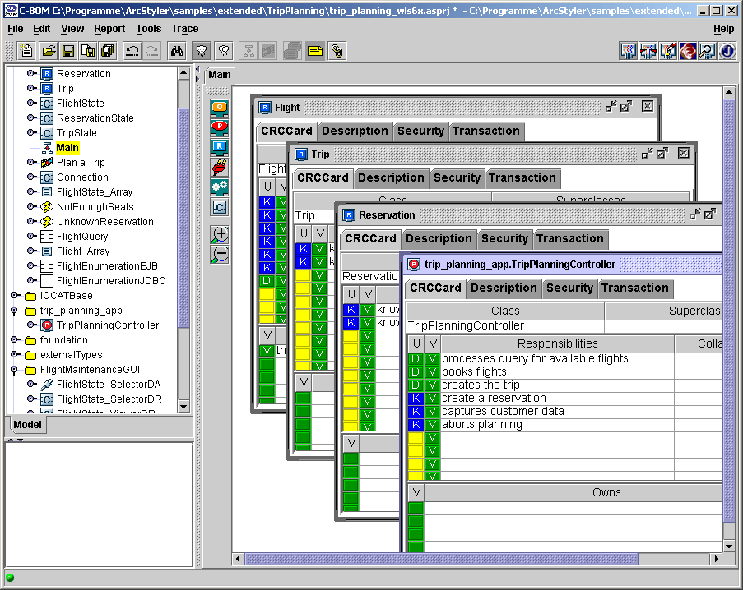
The Convergent Business Modeler

Slide 29
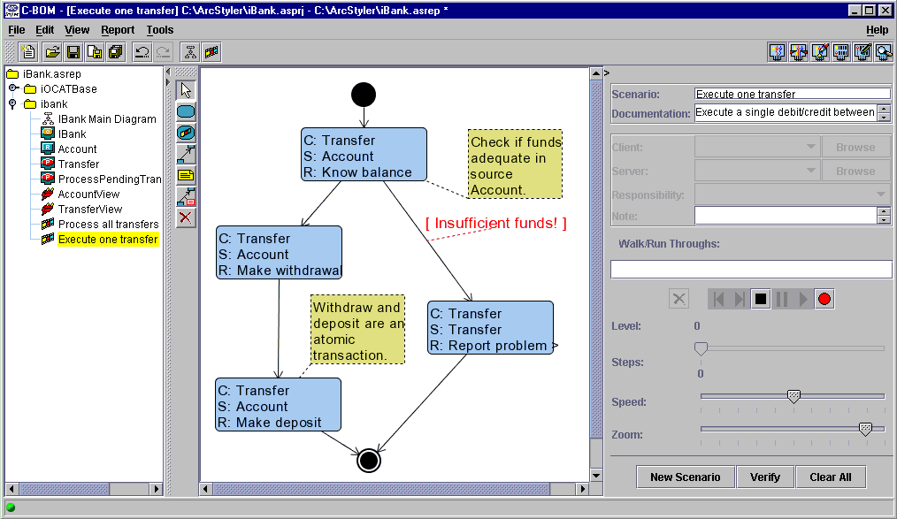

Slide 31
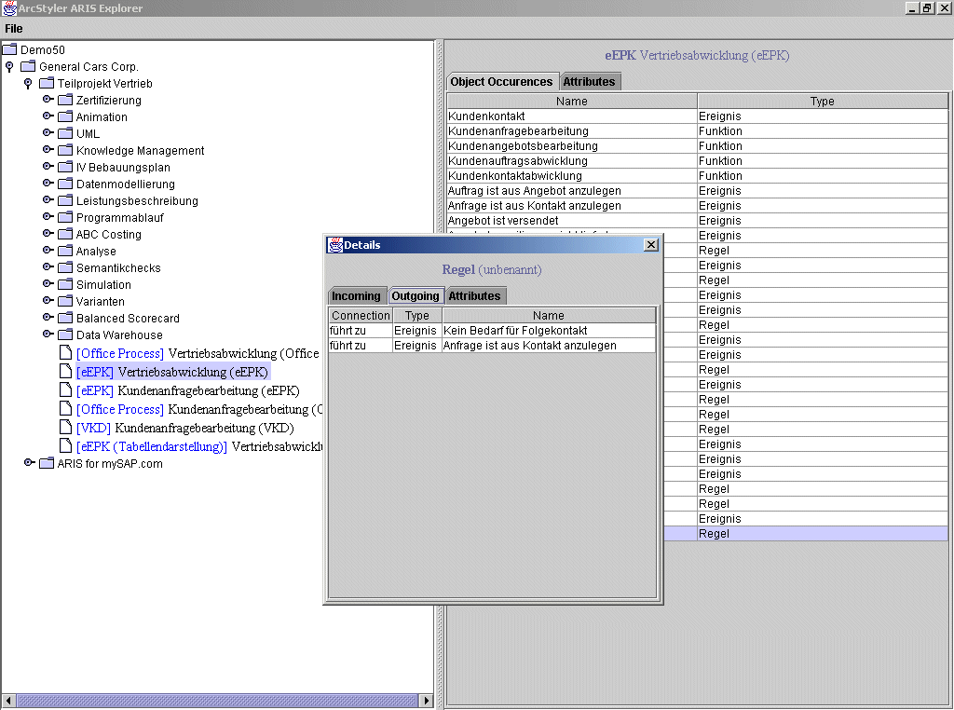

Slide 32
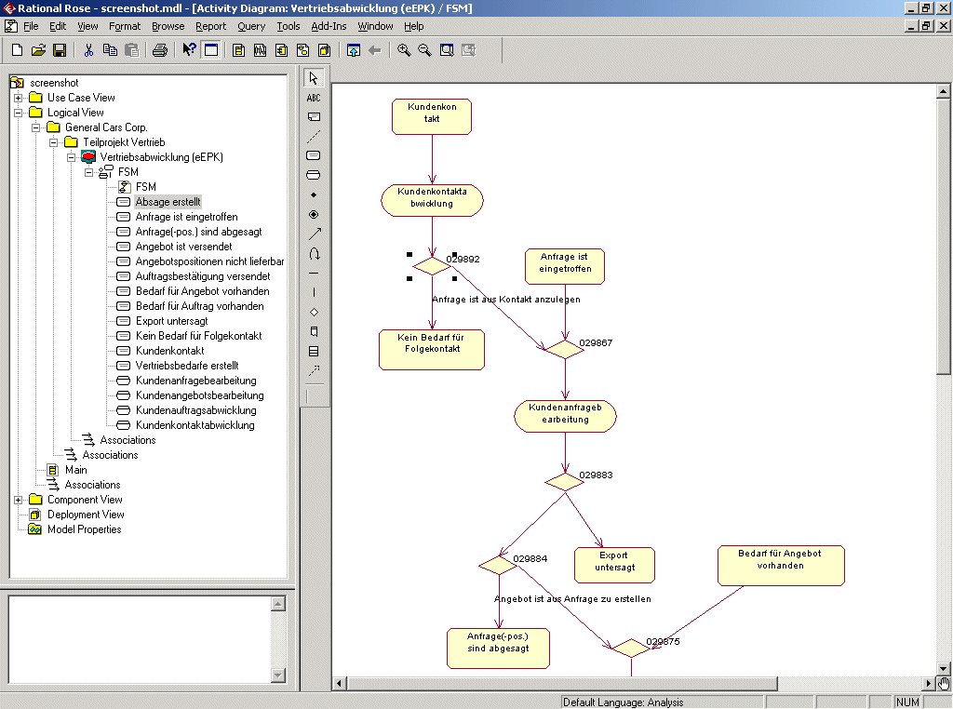

Slide 33
ArcStyler Enterprise Edition
Pattern Refinement Assistant
Bridging the gap between business and UML
  ArcStyler keeps track of the dependencies between business and technology – bi-directional
  Morph your business objects into technology components
  Map responsibilities to UML elements:
  attributes, operations, associations
  Enhance your business model with technology information
Business
Object
Modeler
Pattern
Refinement
Assistant
UML
Refinement
Assistant
Generator
And
Meta-IDE
Test, Build,
Deployment
Support…

Slide 34
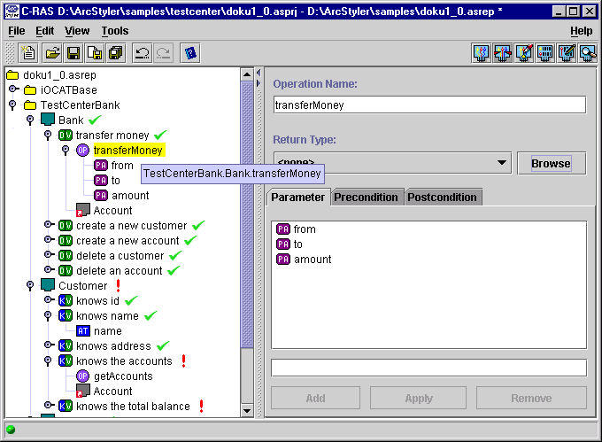

Slide 35
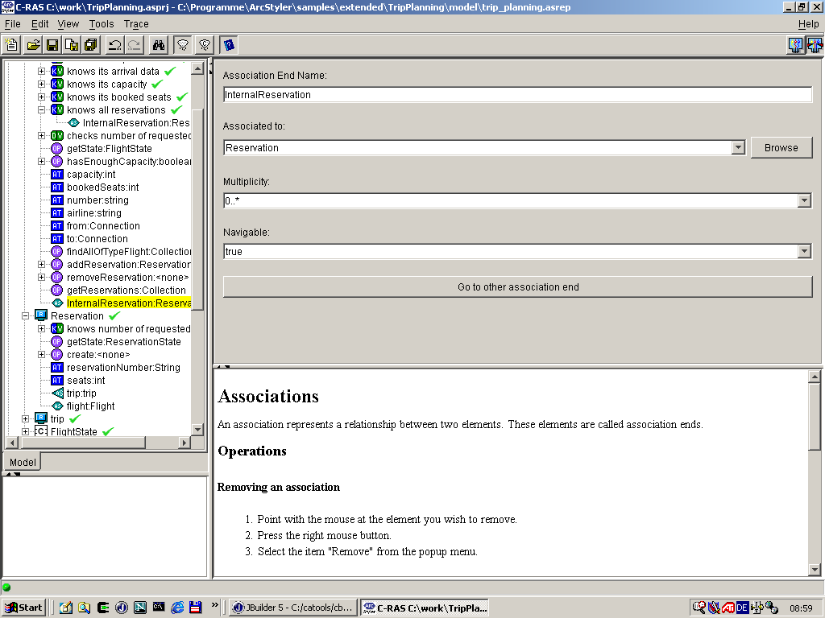

Slide 36
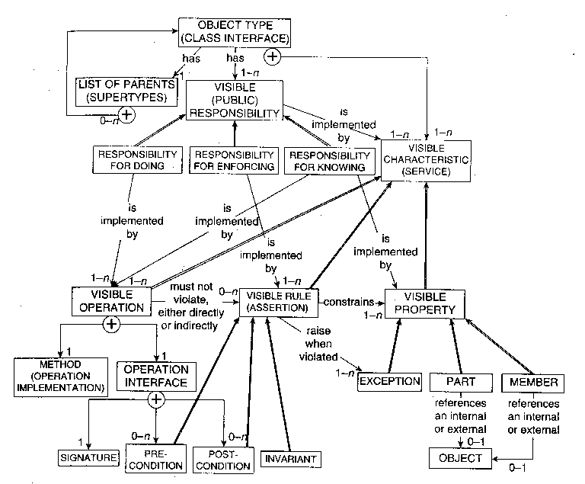
Convergent Mapping with OPEN Patterns
Source: OPEN Toolbox Fig. 2.3
From
BOM
Mapping
via CCC
Patterns

Slide 37
ArcStyler Enterprise Edition
UML Refinement Assistant extending Rational Rose
ArcStyler adds functionality to the leading modeling tool
  EJB specific model / property sheets with default settings
  Application server specific default settings and verification
  O2R/CMP configuration for leading databases / OODB support
  Physical components modeling
  Wizards for backend integration with user/system interfaces
Business
Object
Modeler
Pattern
Refinement
Assistant
UML
Refinement
Assistant
Generator
And
Meta-IDE
Test, Build,
Deployment
Support…

Slide 38
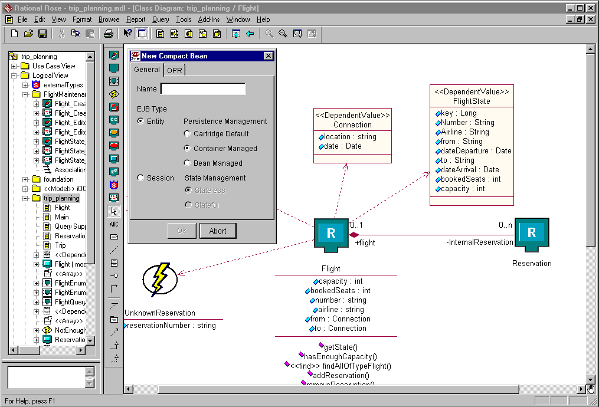

Slide 39
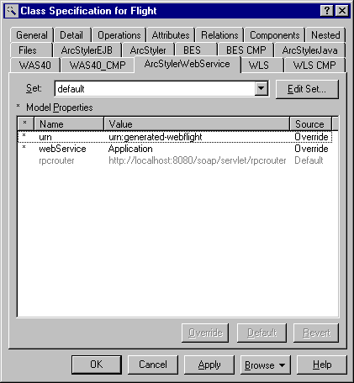
ArcStyler – UML Refinement Assistant
Automatic Web Service enabling. Comprehensive.

Slide 40
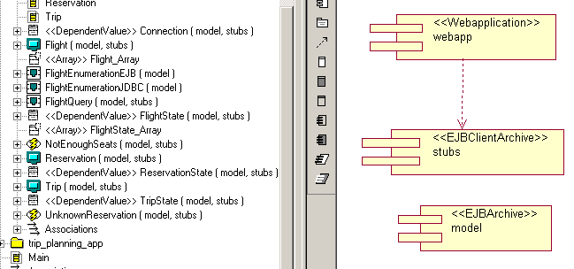
ArcStyler – UML Refinement Assistant
MDA support for Assembly Components (EAR, JAR…)

Slide 41
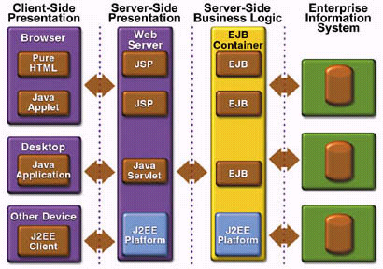
Complete Coverage: Interfaces and Impl.
entity
session
tuned usage
ultra-lightweight/Internet
HTML, WAP etc.
OPR
DB
Notes:
(cf. http://java.sun.com/j2ee/blueprints/)

Slide 42
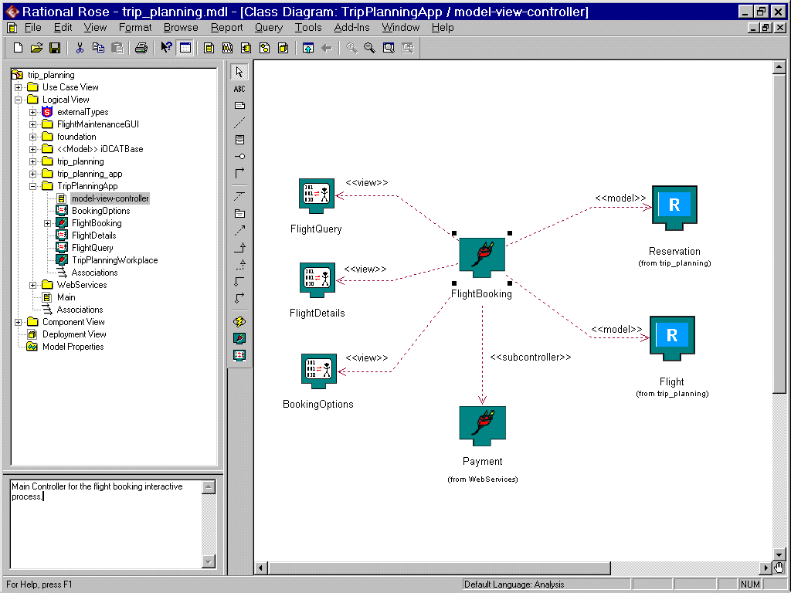
Notes:
5 Screenshots zum ArcStyler 3.0 Accessor
Framework. Die ArcStyler-Specification Dialoge sind im Windows L&F, ging
mit Metal L%F nicht auf Anhieb. Ich hoffe das ist kein Problem (Sieht im
Zusammenhang mit Rose m.E. ohnehin viel besser aus ;-)
1. acc30_srceen_1.gif:
Rose Klassendiagramm mit "Model-View-Controller" Darstellung des
"FlightBooking" Accessors und seiner Abhängigkeiten zu den Representern,
Modell-Klassen und einem untergeordneten Accessor.
2. acc30_srceen_2.gif:
Rose Activitydiagram des o.g. FlightBooking Accessors mit Representer
States (auch komposit und mit Deep History Pseudostate) und Embedded
Accessor State.
3. acc30_srceen_3.gif:
ArcStyler Specification des "FlightDetail" Representers.
4. acc30_srceen_4.gif:
Wie 3. jedoch mit geöffnetem Kontextmenü, das die Menge der
modellierbaren GUI Elemente zeigt.
5. acc30_srceen_5.gif:
Ein "Screenshot der laufenden TripPlanning Application". Zu sehen ist
der FlightQuery Representer.
Das Bild ist kein echter Screenshot. Ich habe die Seite in Ultradev grob
entworfen, dann aber aus Zeitgründen die Feinheiten schnell in
Paint-Shop gemalt. Hoffe, das ist kein Problem. Als Untertitel sollte
dann sowas stehen wie "generated with ArcStyler WebAcessors Cartridge,
layout manually done with UltraDev".

Slide 43
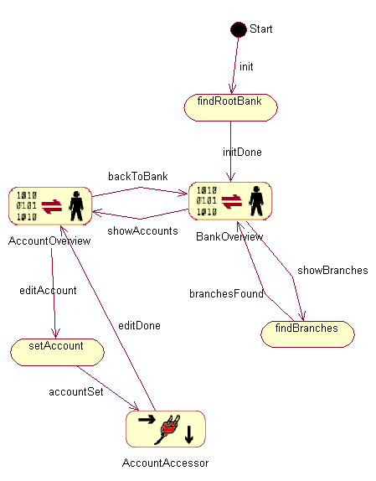
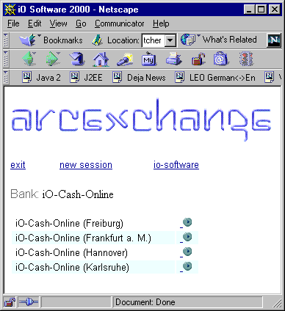
Modelling the entire J2EE flow... generating...
Services

Slide 44
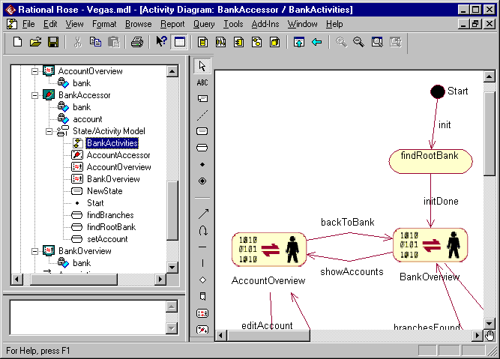

Slide 45
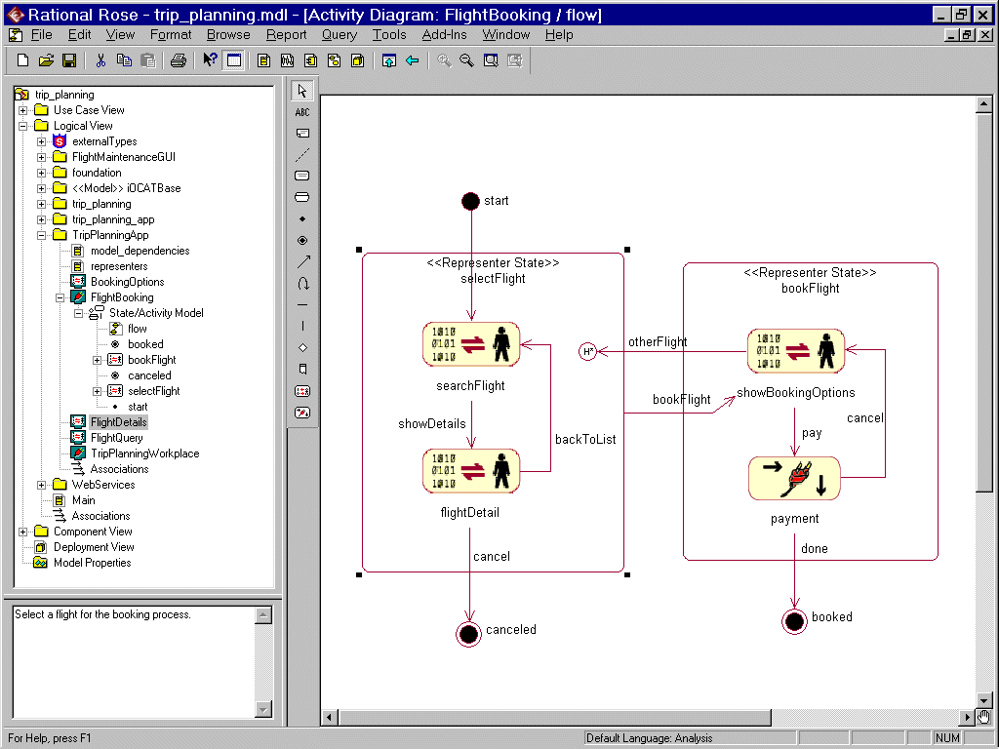

Slide 46
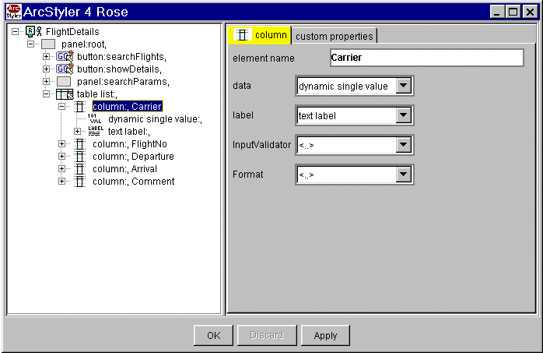

Slide 47
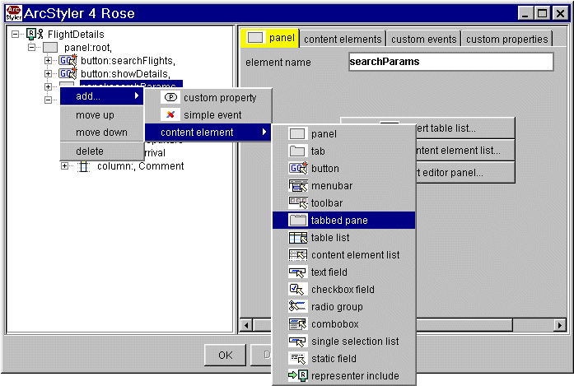

Slide 49
ArcStyler – Automatic MDA Enabling (Harvesting)
Intelligently harvests and MDA-enables existing code
  Adds well-formed MDA modeling style.
  Enables complete Architectural IDE support
  Enables a uniform architectural standards.
Enhances J2EE/EJB/Java with MDA support.
Enables Convergent Architecture

Slide 50
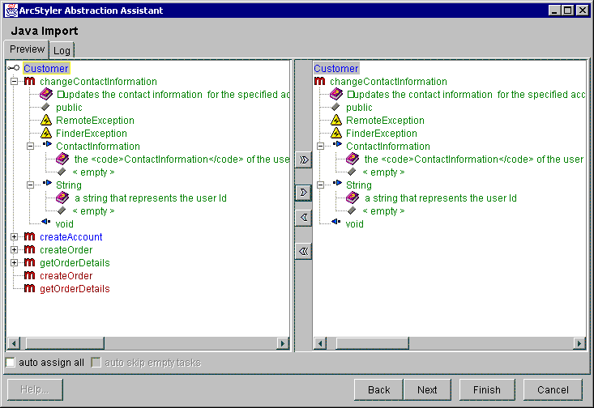
The Code Harvesting Migrator and MDA-Enabler

Slide 51
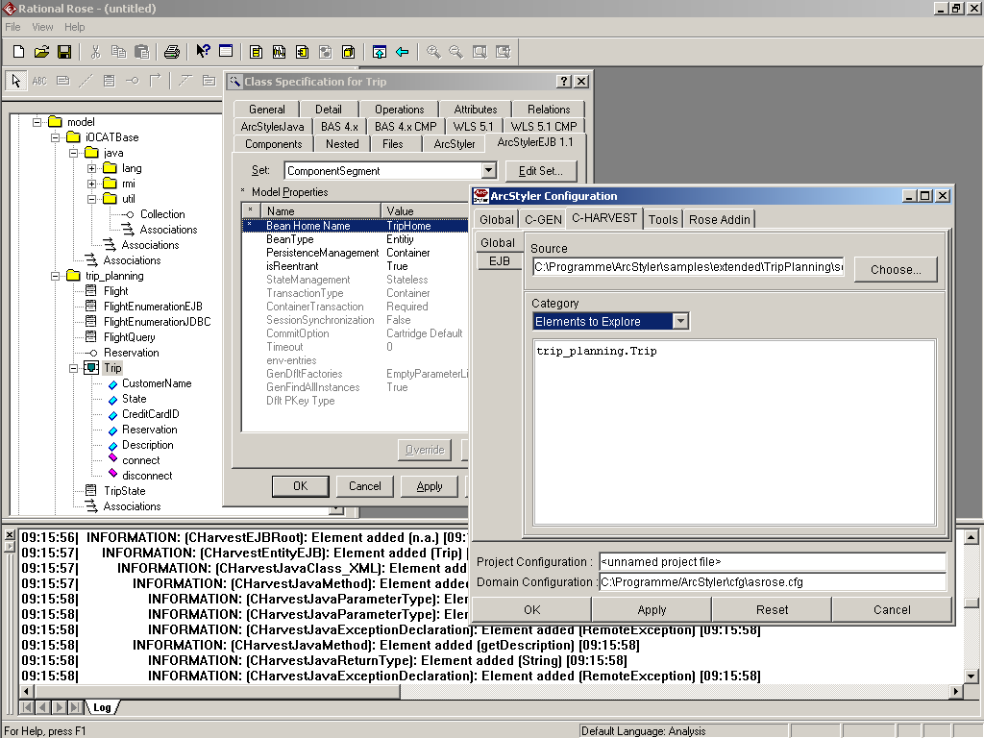
Detailed Exploration
Referenced Java Framework
Flexible Configuration
„Compact“ EJB Components
Hierarchical Action Log

Slide 52
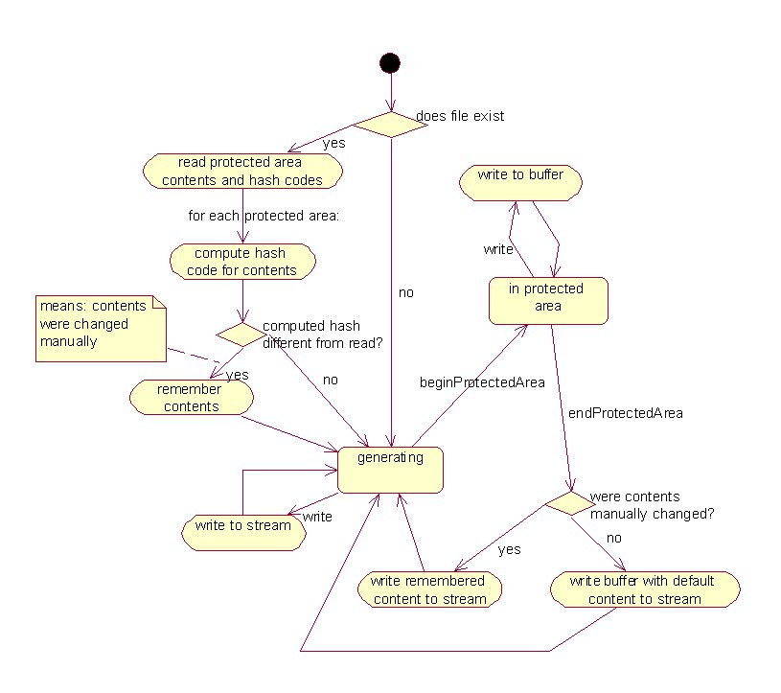
Automated Code Management
The algorithm

Slide 53
ArcStyler – MDA Enabled UML/OCL++
MDA automation for the UML Object Constraint Language
Adds formalized MDA support for constraint modeling.
  Captures business constraints concisely at MDA level.
  Enables more complete specification and documentation.
  Enables more precise and complete code generation.
  Enables more complete test-system generation.
Automation assistants simplify high-end modeling
  Increase expressiveness of models and code generation.
  Standardizes the way designers document complex business behavior.

Slide 54
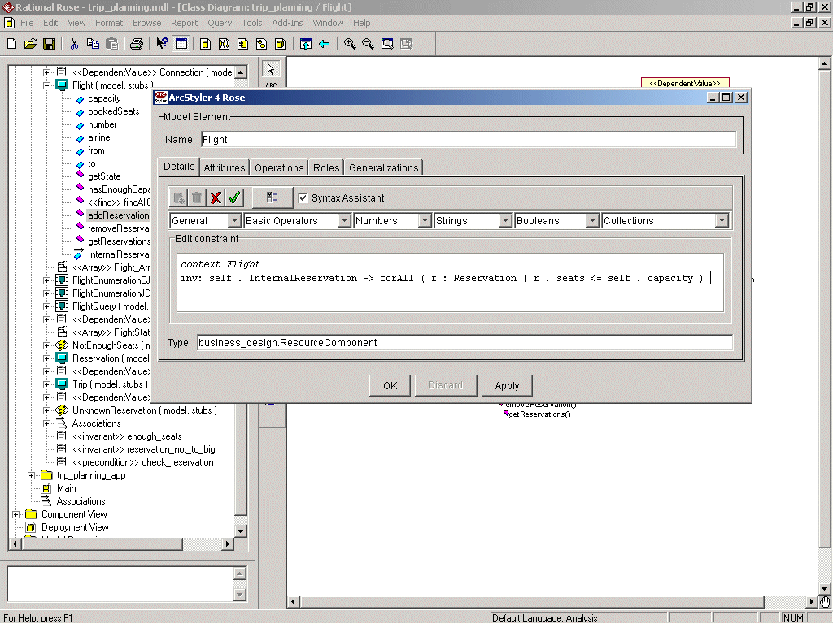

Slide 55
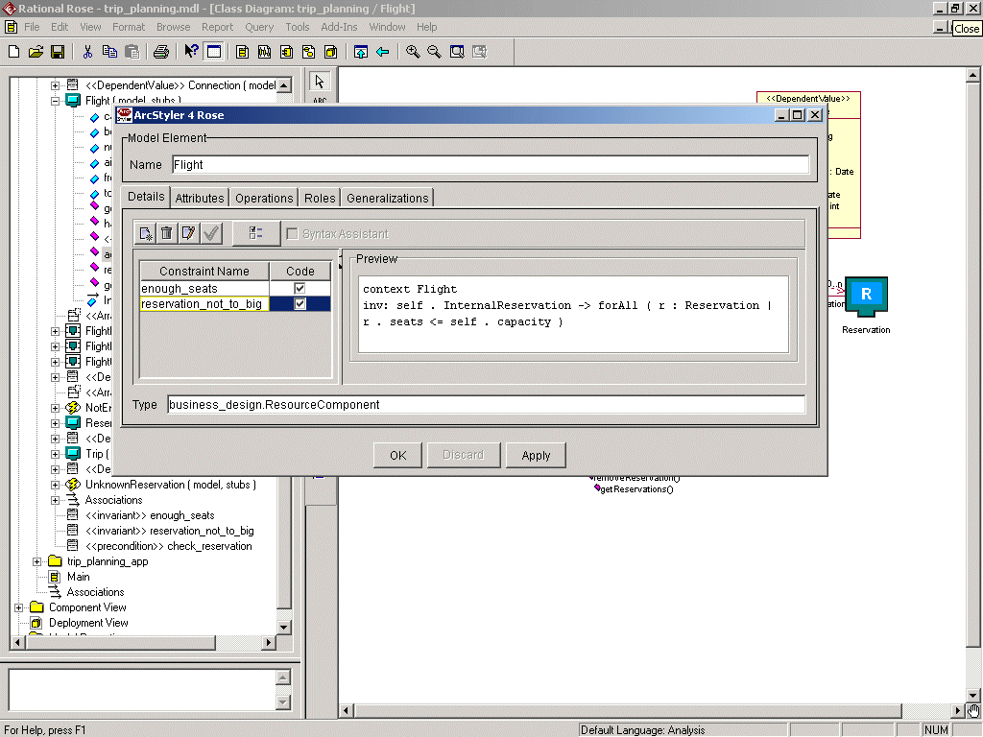

Slide 56
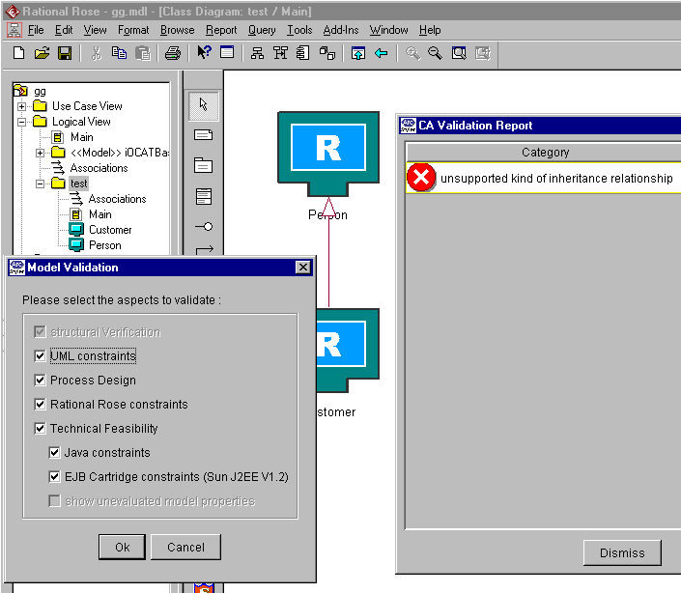
Bi-directional MDA model verifiers.
Bi-directional model verifiers (patented)
Model consistency checks – signals constraint violations
Advanced capabilities propagation and checking
  The verifier knows the
  capabilities of the currently
  configured cartridge
  The model can be verified
  for technical feasibility
  at design time
§ contains iO patented technology

Slide 57
ArcStyler Enterprise Edition
Generator
Pluggable generator architecture with specific cartridges
  Executable EJBs – ready to run optimized for the app server
  Classes, interfaces, exceptions, dependent values
  with all methods and configuration needed to run the EJBs
  EJB archives, Java archives EJB client archives
  Code to access EJBs from servlets
  Automatic configuration of application server and database
Business
Object
Modeler
Pattern
Refinement
Assistant
UML
Refinement
Assistant
Generator
And
Meta-IDE
Test, Build,
Deployment
Support…

Slide 59
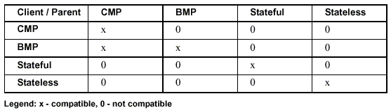
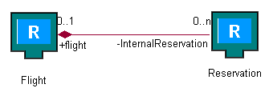
Comprehensive Infrastructure Management
High-end, not just skeletal. E.g. Inheritance:
E.g. EJB references in the deployment descriptors
  Beans can be packaged in different EJB archives, but then presence of all archives connected by associations is required at runtime
E.g. Foreign Key mapping to DB.

Slide 60
ArcStyler Enterprise Edition
Extensions, State Machine and Build Support
Supports the leading IDE and standard build process
  Container independent EJB association management
  State machine for the web applications
  Synchronizes and configures Java IDE (JBuilder)
  Generates scripts for ANT build, deploy and test environment
  Build and project support for out-of-the-box hot deployment
  Enables rapid and future-safe development
Business
Object
Modeler
Pattern
Refinement
Assistant
UML
Refinement
Assistant
Generator
And
Meta-IDE
Test, Build,
Deployment
Support…

Slide 61
ArcStyler – Build, Deploy, Test Support
ANT Build environment
  Build targets configured with all paths, packages and libraries
  Database schema creation
  Start / stop optimized for specific environments and server
Programming IDE Support (e.g. Jbuilder)
Test environment
  Generation of test clients and classes
  JUnit test cases

Slide 62
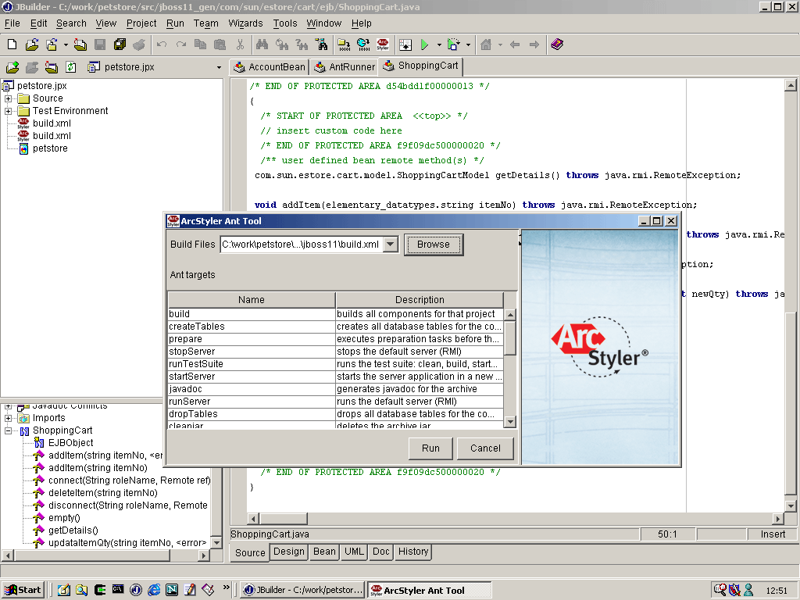
ArcStyler ANT Build, Deploy, Test Tool

Slide 63
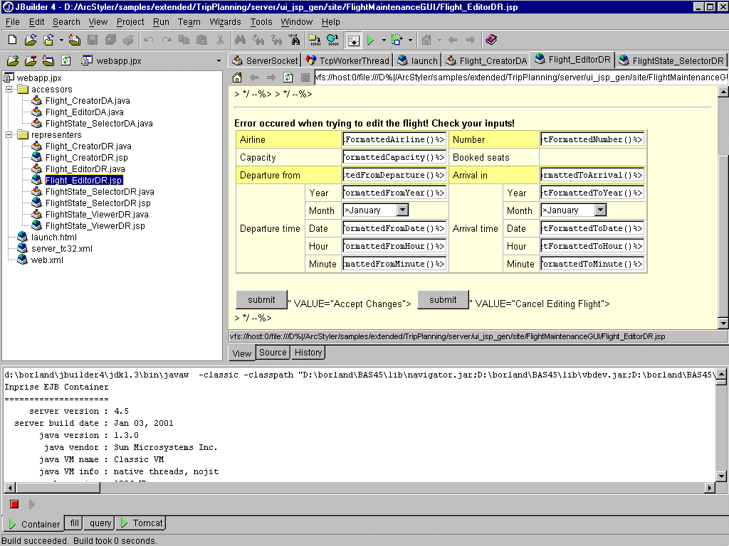

Slide 65

C-GEN: Automation of Tech. Projection
Technology
mapping as
ArcStyler Cartridge
IT-Dimension
as finished
EJB Impl.
specific JARs.
=> Deployment
Parts of Business
Dimension and
skeleton code
for completion by
developer.
Ejb.tpl
Bean.tpl
Home.tpl
Remote.tpl
C-REF Rose Assistant
sync/native
C-MOD Repository
100% Java
UML1.3
EJB/CCM
Open API
arch
C-GEN
EJB
Container
JPython
exchange, merge, evolve
XML/XMI

Slide 66
ArcStyler Enterprise Edition Cartridges
Technology Projection
  Separates infrastructure code from logic code
  No unintended technology dependencies
  Different innovation cycles
  Vendor independence
Pluggable Cartridge Architecture
  Exchange the Cartridge and have all infrastructure code optimized for the new platform
  Higher ROI through longer life cycle of applications

Slide 67
ArcStyler Architect Edition
Business
Object
Modeler
Pattern
Refinement
Assistant
UML
Refinement
Assistant
Generator
And
Meta-IDE
Test, Build,
Deployment
Support…
Corporate Architectural Style Builder
  Custom MDA for the specific architectural needs of the organization
  Distribute the new automated architectural style as an MDA Cartridge
  May be based on existing MDA Cartridges or new, from scratch.
Uses MDA: Cartridge development is also model driven
  Patent pending model driven CARAT (Cartridge Architecture)
  In the visual ArcStyler Meta-programming Environment (MPE)
Used today to MDA-enable host and legacy technologies
  Leverage existing, custom, external environments…
Notes:
25 Jahre gewachsene IT Infrastruktur -> auf eine Projekte verweisen ...
C, Assembler, IMS hierarchische Datenbank
Never touch a running system
Schulen, Experten einkaufen, schnellere Technologiezyklen
Generator wie Compiler, Reduktion von Arbeit, da Code für viele Stellen generiert, Akzeptanz wie früher Assembler und dann C
Businesslogik jedes mal neu programmieren oder an alten Technologien festhalten
Pilot- oder PreSales Projekte – daraus erwächst Projekt – hinterher nur Visualisierung
Paralleles Testen
Jede Abteilung macht die gleichen Erfahrungen von neuem
Technische Anforderungen
Fachliche Anforderungen
Erfolgsanforderungen
Zukunftssicher, Anpassbar, Dokumentiert

Slide 68
ArcStyler CARAT: The “PostScript Standard” for MDA Cartridges
CARAT
™
Pluggable MDA™ Cartridges
standard
Use
Cartridges
Set Gen. Options
Configure Server
Add Cartridges
MDA Programming IDE
Produce
Cartridges
Custom Infrastructure
CORBA, .NET,
OODB, COBOL, etc.
Architectural IDE
Model & Gen.
Refine & Test
Package Cartridge
PostScript
™
Pluggable Print Drivers
standard
Install
Printer
Driver
Desktop Publishing
Systems
Set Print Options
Configure Printer
Install Printers

Slide 69
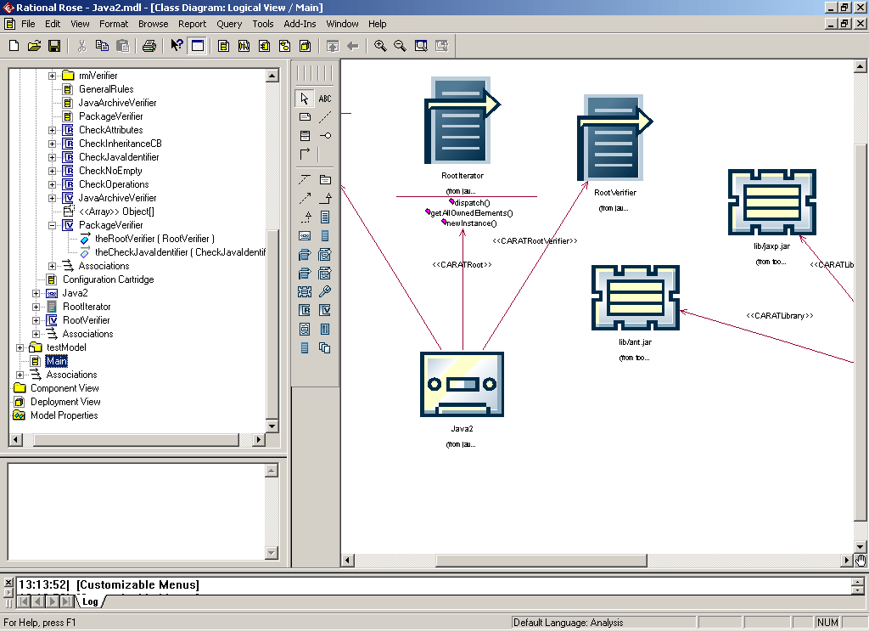
The MDA-IDE: Model-Driven Cartridge Development

Slide 71
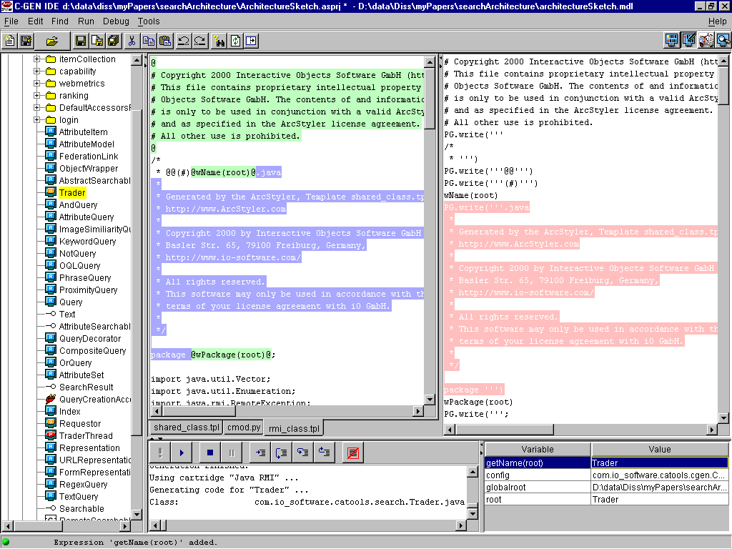
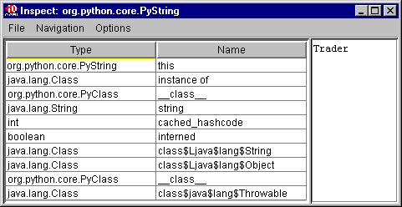
C-BOM
C-RAS
C-REF
C-GEN
C-BOB

Slide 72
ArcStyler 3.0 in April 2002…
Improves ArcStyler as a runtime platform for standard and custom MDA Cartridges, whether developed by iO, its customers or partners.
Every P-Stack is a self contained MDA Cartridge. New/extended standard MDA Cartridges for
  MDA Security Cartridge(s)
  MDA IDS Cartridge (IDS Integration)
  MDA Enabling Cartridges (Harvesting)
  MDA Searchability Cartridge (NWS)
  MDA .NET Cartridge (*)
Custom MDA Cartridges (e.g. Host) by our partners.

Slide 73
Model Driven Architecture
for the Enterprise
Interactive Objects Software GmbH
Basler Strasse 65
79100 Freiburg, Germany
Tel. [+49] 761 / 4 00 73 - 0
Fax [+49] 761 / 4 00 73 – 73
info@io-software.com
http://www.ArcStyler.com/
January 28, 2002
iO_ArcStyler.ppt
© Interactive Objects Software – info@io-software.com

